Slide 1
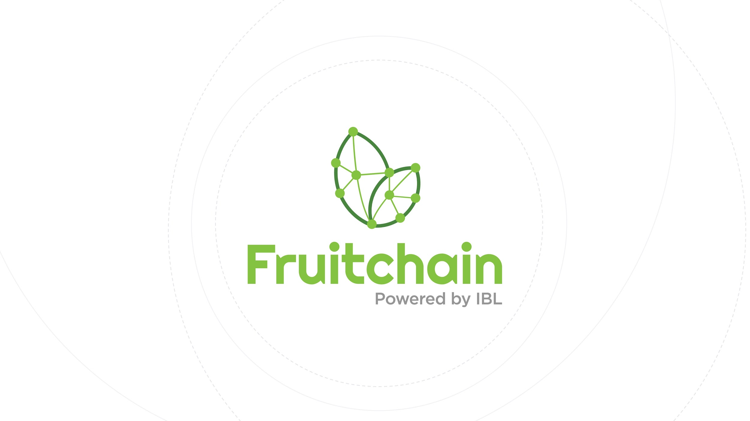

Wowtrace
- We WOW the AgriWorld -
Notes:
INTRODUCTION

Slide 2

1. APPLICATION INTRODUCTION
2. HOW IT WORKS
CONTENT
3. BUSINESS APPLICATION
4. TEAM PROFILE
Notes:
CONTENT

Slide 3

EXECUTIVE SUMMARY
Wowtrace provides a total solution combining IoT and Blockchain technologies on Cloud platforms and infrastructures. This is dedicated to enhancing Sustainable Growth and Transparency from Farm-to-Fork, as well as encouraging Business Ethics and Corporate Social Responsibility. Thereby, we pave the way for Vietnamese agricultural commodities to join the global value chain.
ABCI = AI x Blockchain x Cloud x IoT
Notes:
INTRODUCTION

Slide 4

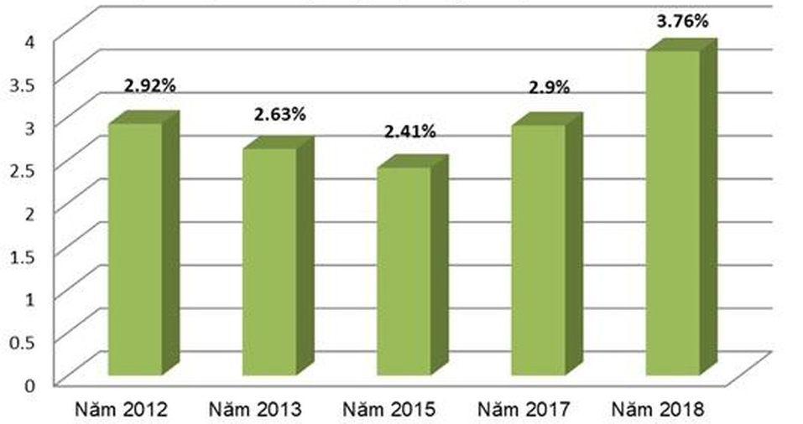


BUSINESS OPPORTUNITIES
Vietnam’s agriculture is a major player in national economy & has made enormous progress.
Statistics in 2018:
Growth rate reaches the peak in recent 7 years: 3.76%
Export value hits the record 40.02 billion USD
World top ranking for export Rice, coffee, rubber, tea, black pepper, coconut,...
Vietnam Agriculture GDP Growth (2012 - 2018)
Notes:
The potential size of the market you are addressing. Why we tap on this industry of agriculture because … particularly in 2018

Slide 5
PROBLEM STATEMENTS
The food supply chain is the most complex and fragmented of all supply chains with various producers and intermediaries and creates uncertainty and risk.
Farmers miss many opportunities to export their products because food safety & quality are underqualified or unprovable & untraceable.
Lack of transparency & credibility among multiple stakeholders in agricultural supply chain
Farming productivity is still low because of ineffective farming method & lack of technology support.
Notes:
Reference: https://english.vov.vn/trade/vietnams-farm-produce-struggles-to-overcome-technical-barriers-382493.vov

Slide 6
APPLICATION INTRODUCTION
Smart Farm Management
IoT sensor integration
Real-time Data Analysis (AI)
Predictive Analysis (Machine Learning)
Transparent Traceability
IoT sensors for Data inputs
Blockchain for Secure, Immutable & Decentralized Database
Notes:
TITLE

Slide 7
HOW IT WORKS (1)
Make the Farm SMART Again
Use multiple IoT sensors to collect telemetry data in real-time thank to AWS IoT platform
Store the data in a database powered by big data technology
Analyze data with various machine learning algorithms for insights
Data mining algorithms for best agricultural production practices
Machine learning algorithms to early detect abnormals and perform predictive analyses
Display real-time data and analysis outcomes on the dashboard over smart devices (TV, PC, smartphone, etc.)
Notify farmer with important events for timely reactions
Notes:
INTRODUCTION

Slide 8
HOW IT WORKS (2)
Make the Farm TRANSPARENT Again
Employ blockchain as a verifiable and tampering-resistant database to provide proof-of-transparency of the physical products
Store telemetry data footprints periodically in blockchain to provide proof-of-origin of historical data
Use QR-code stickers for identifying and tracking agricultural products
Store transaction data in blockchain to provide proof-of-untampered transactions of various roles like farmers/producers, distributors, and retailer
Use QR code reader (e.g., smartphone) to view “all” information of agricultural products
Notes:
INTRODUCTION

Slide 9
UNIQUENESS
WOW 1
Total track-and-trace solution including Internal and External Traceability “to identify and trace the history, distribution, location and application of products, parts and materials” (UN Global Compact’s definition of traceability system)
WOW 2
Absolute data integrity and business transparency through Consortium Blockchain technology while still be able to handle significant data throughput.
WOW 3
Knowing detailed and real-time data of agriculture products via the total integration of the latest technology sets - ABCI
ABCI = AI x Blockchain x Cloud x IoT
Notes:
Value proposition - Focus

Slide 10
BUSINESS APPLICATION
WOW supports FARMERS
Timely reactions to unexpected conditions
Proactive actions by anticipating future events
Crop quality improvement with best practices suggested by machine learning
→ Increase productivity while minimizing human mistakes
WOW enhances the WHOLE SUPPLY CHAIN
Data automatically collected by sensors to reduce risks of fraud and error.
Credibility & transparency amongst related independent parties in the supply chain from farmers/ producers - distributors - retailers - consumers
→ Gain transparency & credibility
Notes:
INTRODUCTION

Slide 11
BUSINESS APPLICATION
WOW for mass adoption
Consumers demand transparency about food safety and environment caring
Not necessarily adopt cryptocurrency/tokens
Friendly UI and UX with no app installation or software set-up required
→ Brings what consumers need in the way they want
WOW for social mission
Increases confidence in data integrity and reduces risk from counterfeits, business frauds, and gray markets.
More safety, more trust, more efficiency for food supply chain
→ The better food we have, the better life we live
Notes:
INTRODUCTION

Slide 12
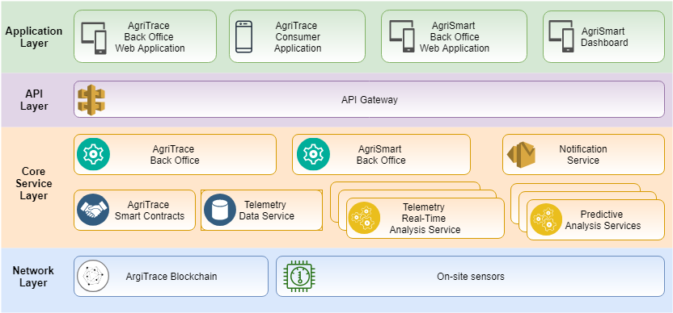
COMPONENT STACK
Notes:
Focus

Slide 13
DEVELOPMENT MILESTONES
Milestone #1
Supply Chain PoC
Supply Chain MVP
AgriTrace BackOffice Web
Consumer Web
Milestone #2
Telemetry data service PoC
Telemetry data service MVP
AgriSmart MVP
AgriSmart BackOffice MVP
AgriSmart Dashboard MVP
Milestone #3
Enhanced Supply Chain (w/ telemetry data)
AgriTrace BackOffice Web
Consumer Web
Enhanced AgriSmart
AgriSmart BackOffice and Dashboard
Milestone #4
Real-time analysis PoC
Predictive analysis PoC
First MVP of real-time analysis
Guideline for analysis development
Notes:
Focus

Slide 14
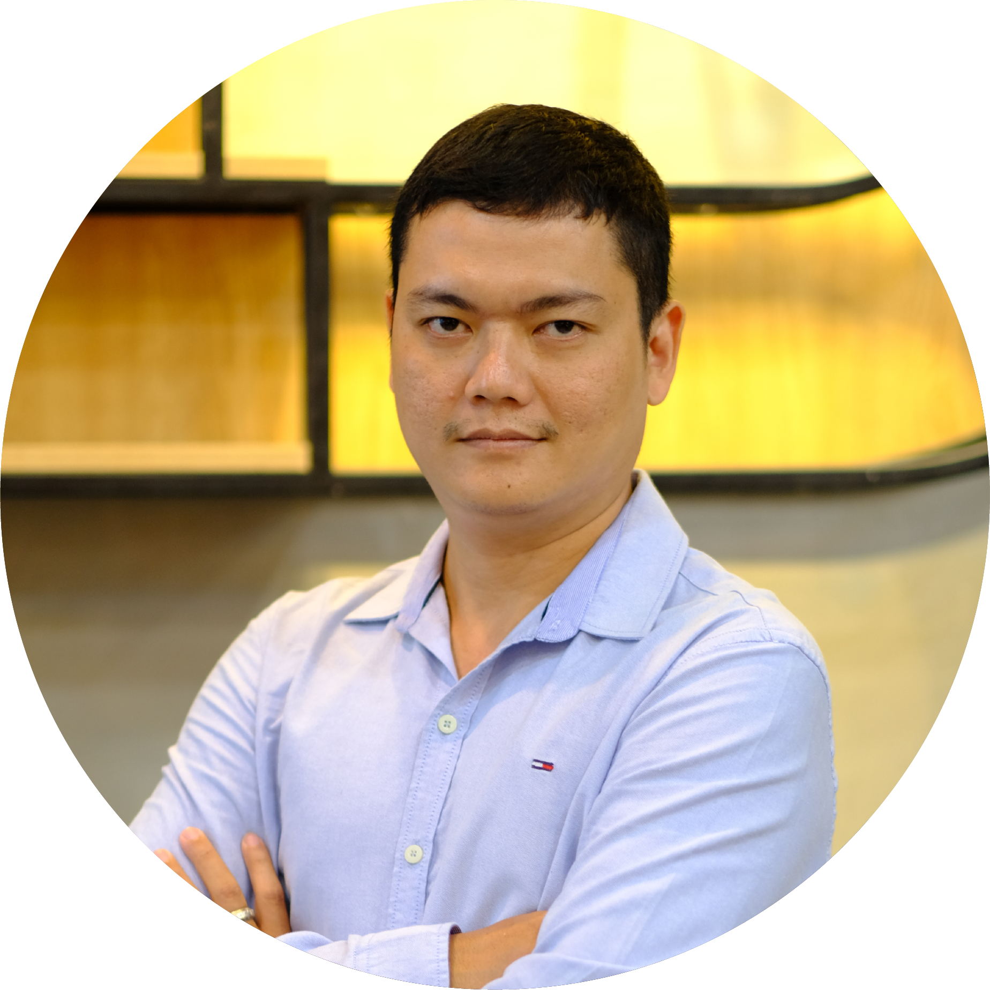
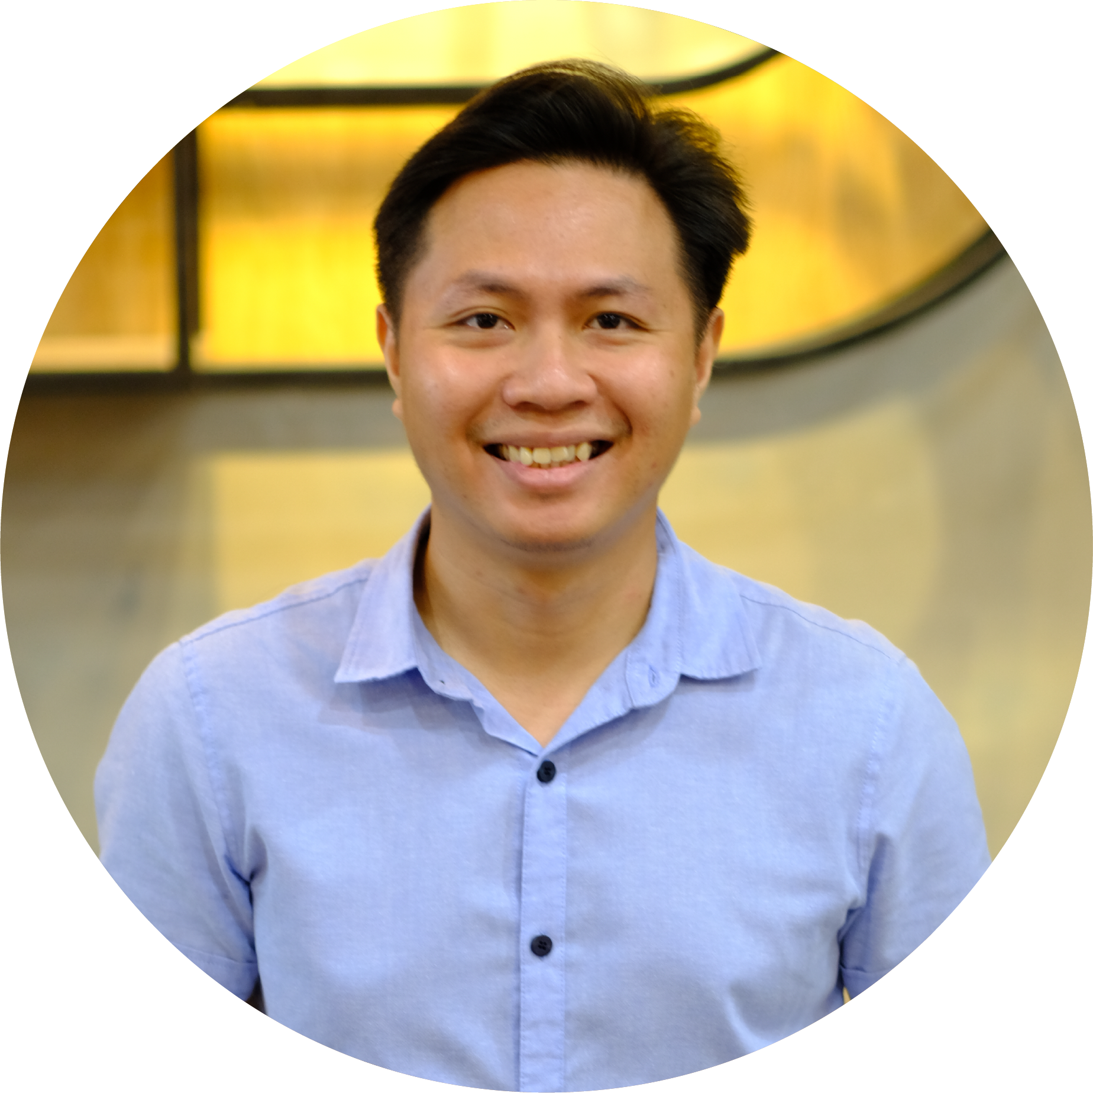
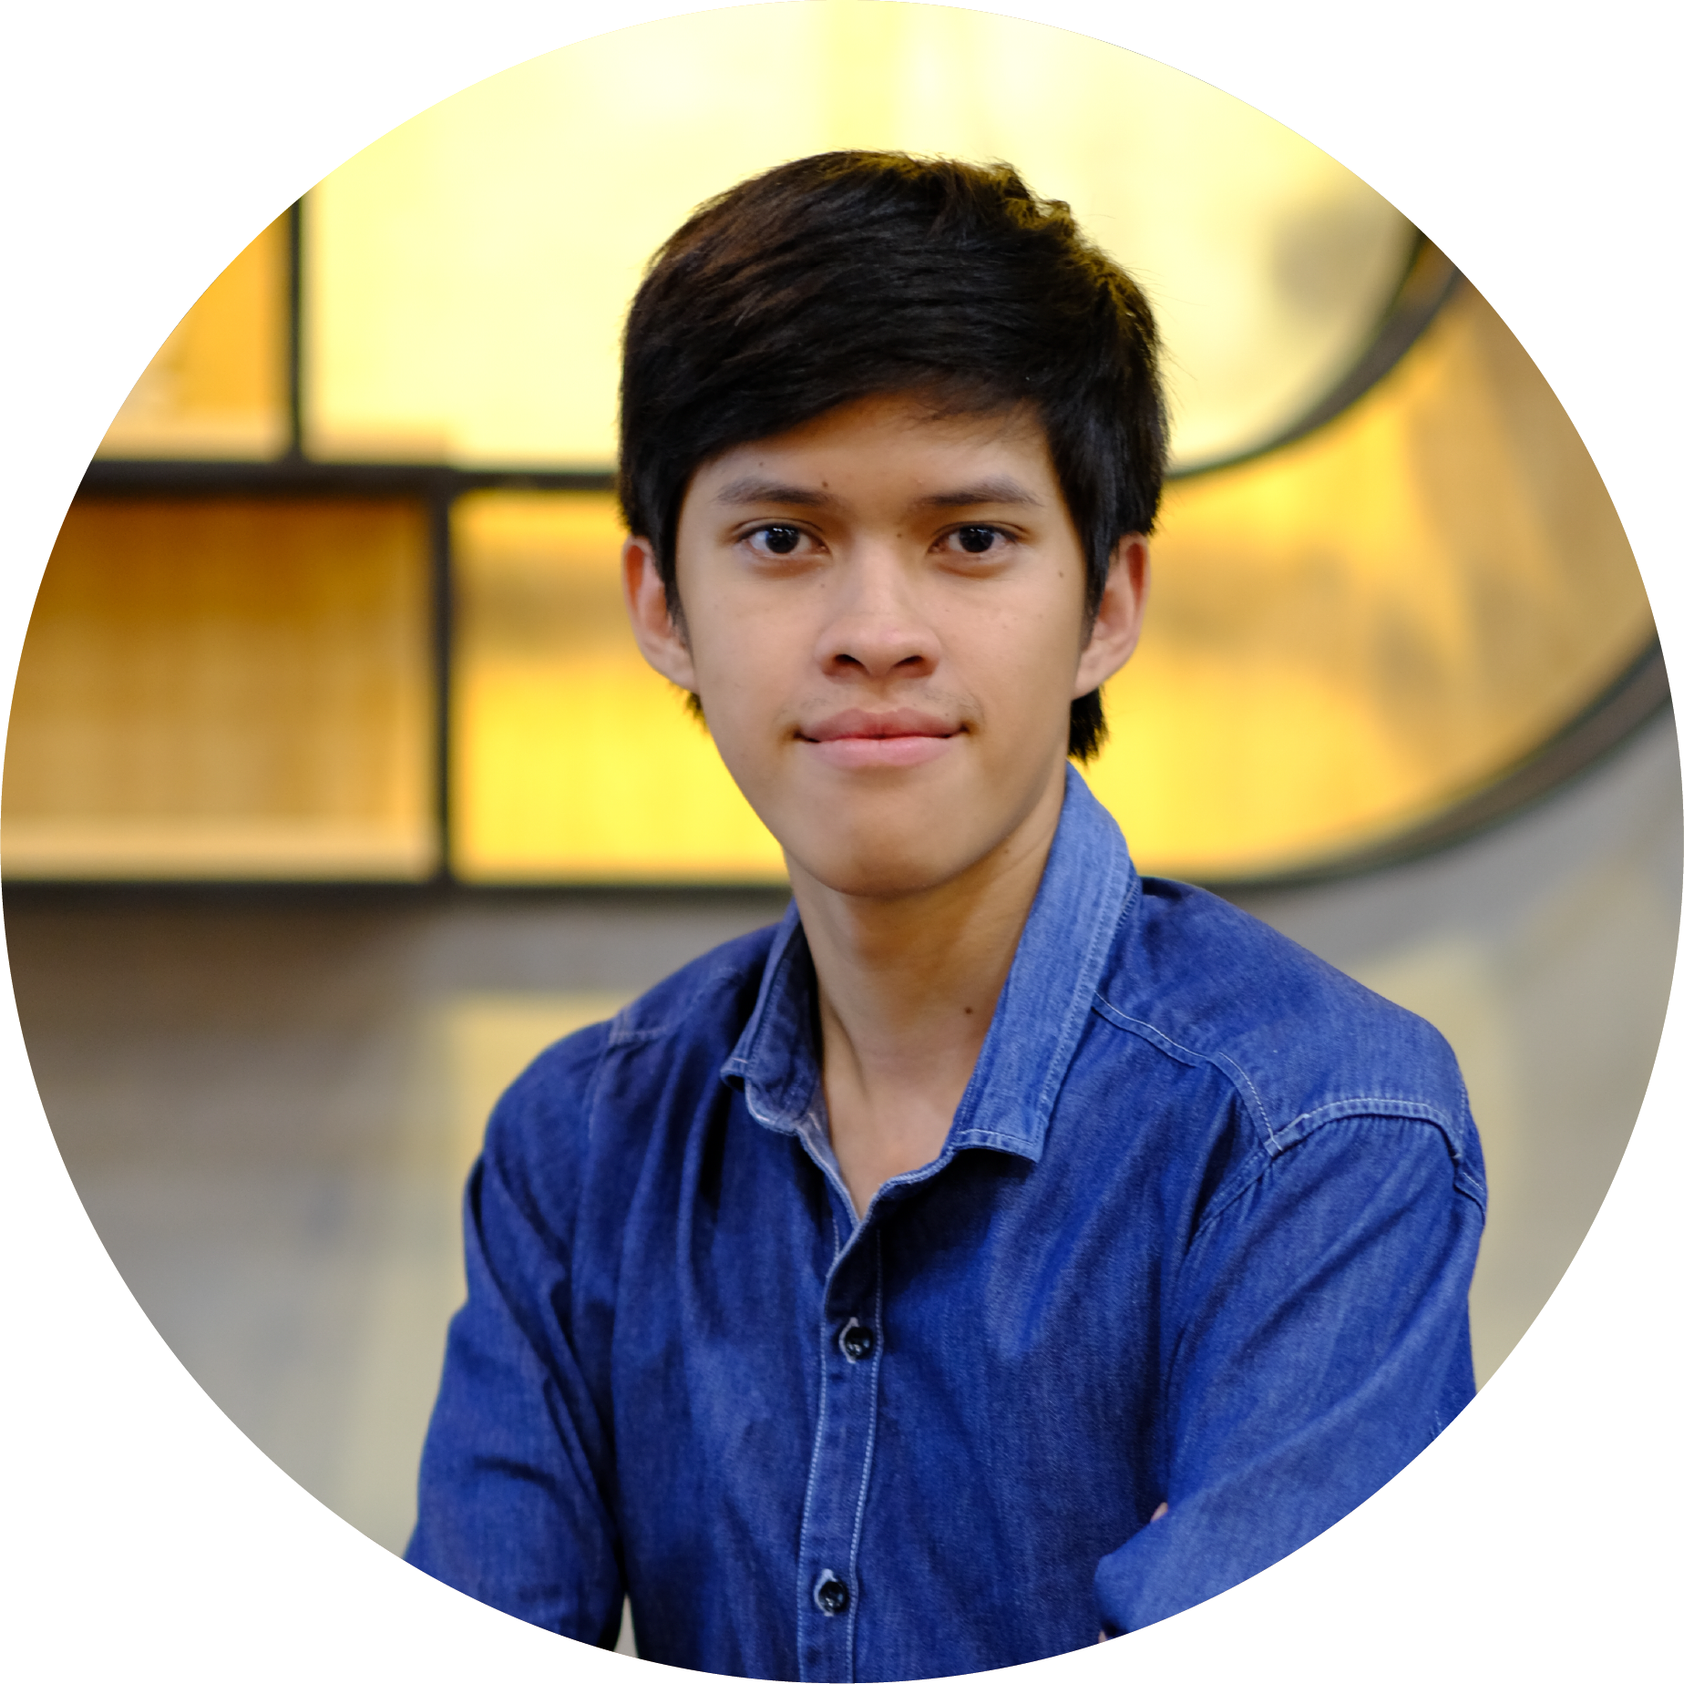
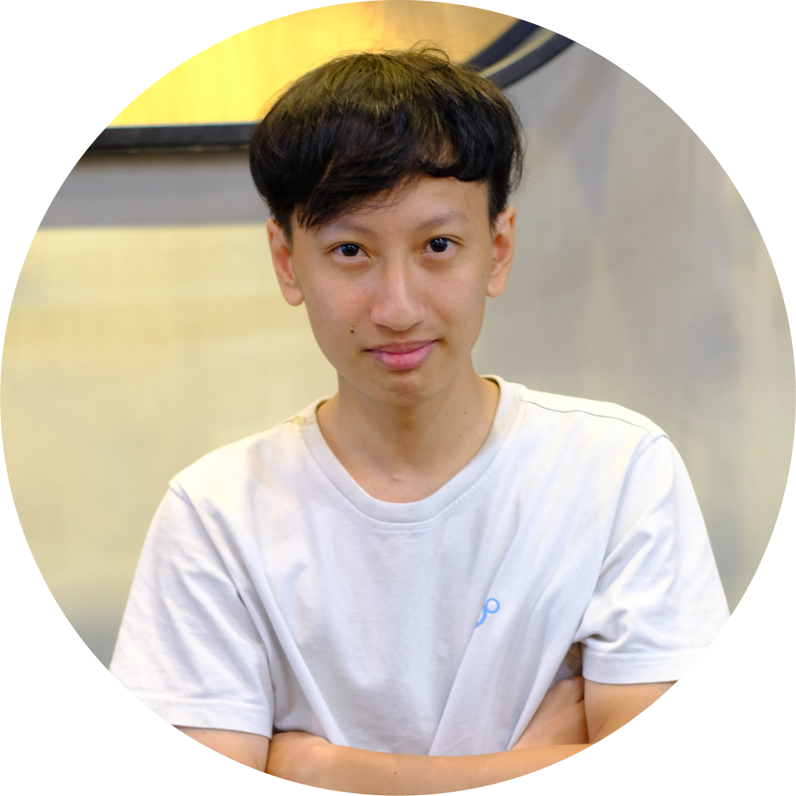
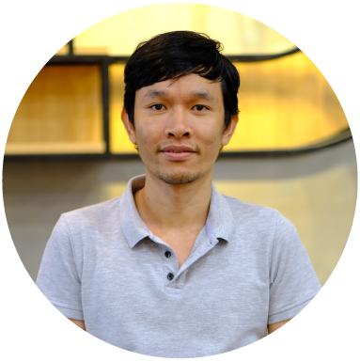
TEAM PROFILE
Nam Nguyen
Project Director
Tan Do
Technical Leader
Phuong Do
Blockchain Developer
Dat Ha
Backend Developer
Luan Do
Blockchain Developer
+12 years experience in Business Development and Finance Analysis/Analytics positions at various international companies. He believes that blockchain technology shall play an influential role in all existing industries.
+7 years experience in developing complex web-based applications, and processes. He focuses on quality, involved in identifying best practices, technologies, and standards.
Graduated from University of Technology and finished at top 2 of IBL internship program. Phương wants to become professional blockchain developer.
+ 12 years of experience in software. He also gained the Best paper award – a conference for Young Researcher 2014 in University of Information Technology.
Graduated from University of Science. He has 2 year experience as full stack developer.
Notes:
INTRODUCTION

Slide 15

THANK YOU

